Slide 1

Circular Linked List; Operations on a Linked List (Insertion Deletion and Traversal)
Data Structure | Introduction to Data Structure
Course: Data Structure | Chapter: Introduction to Data Structure | Program: Bachelor of Engineering
DISCOVER · LEARN · EMPOWER
Notes:
Welcome everyone to today's lecture on Circular Linked Lists. We will explore how this structure differs from standard linear lists and why it is useful for specific applications like round-robin scheduling. By the end of this session, you will be able to implement insertion and deletion operations effectively.

Slide 2
Course Outcomes
SLIDE 2 / 10
Course Outcome
CO | BT LEVEL | DESCRIPTION
CO1 | BT1 | Understand and apply basic data structures, algorithms, complexity analysis, ADTs, arrays and linked lists.
CO2 | BT2 | Apply and implement stacks and queues in problem-solving.
CO3 | BT3 | Analyse and apply searching, sorting, and hashing techniques.
CO4 | BT4 | Construct and apply tree structures and traversal techniques.
CO5 | BT5 | Represent and solve graph problems using DFS, BFS, and graph algorithms.
Chandigarh University
2 / 10
Notes:
Today's lecture directly supports our Course Outcomes. CO2 is addressed as we treat the circular list as a specialized queue mechanism for problem-solving. CO4 is relevant because understanding linear structures is a prerequisite for constructing complex tree traversals later in the course.

Slide 3
Learning Objectives
SLIDE 3 / 10
Learning Outcomes
1
Define the unique structural properties of a Circular Linked List.
2
Analyze the traversal logic required to visit all nodes without infinite loops.
3
Implement insertion algorithms for head, tail, and specific positions.
4
Evaluate deletion strategies for maintaining list continuity and memory safety.
Chandigarh University
3 / 10
Notes:
Our goal is to move beyond simple definitions. You will analyze how traversal stops correctly when the next node is the head. We will implement insertion at the head and tail, which are common operations in circular buffers. Finally, we will evaluate deletion to ensure the list remains connected.

Slide 4
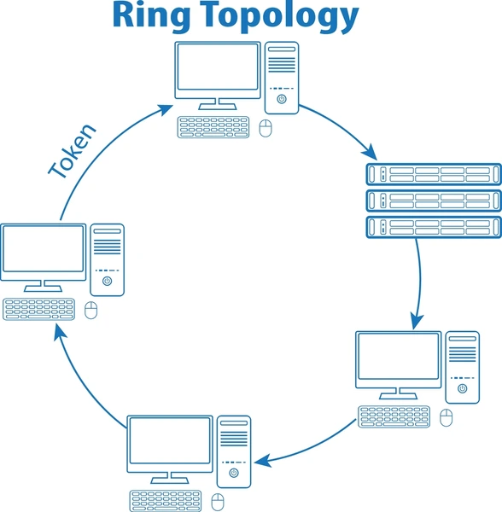
Lecture
SLIDE 4 / 10
Definition of Circular Linked List
1
A circular linked list connects the last node's next pointer back to the first node.
2
There is no null pointer at the end, creating a continuous loop of nodes.
3
The head node serves as both the starting point and the reference for the end.
4
This structure allows traversal to continue indefinitely until a specific stopping condition is met.
Ring Topology: How It Works and Where It's Used
Chandigarh University
4 / 10
Notes:
Imagine a necklace where the clasp connects the last bead back to the first. In a standard list, the last node points to null, but here it points to the head. This creates a loop where you can start anywhere and eventually visit every node. It is ideal for applications requiring continuous rotation.

Slide 5
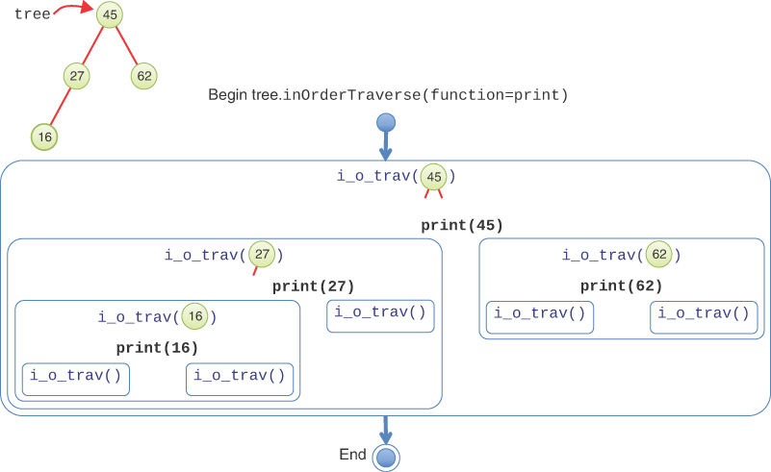
Lecture
SLIDE 5 / 10
Traversal Logic and Termination
GOVERNING EQUATION
Termination condition is (current->next == head) to prevent infinite looping
1
Traversal starts at the head node and proceeds to the next node sequentially.
2
The loop continues until the current node's next pointer equals the head node.
3
A do-while loop structure is typically used to ensure the head is processed first.
Source: www.informit.com
Chandigarh University
5 / 10
Notes:
To traverse this list, you must use a do-while loop because you need to process the head node before checking the condition. If you use a while loop, you might skip the first node. The condition checks if the next node is the head, ensuring you stop after visiting everyone exactly once.

Slide 6
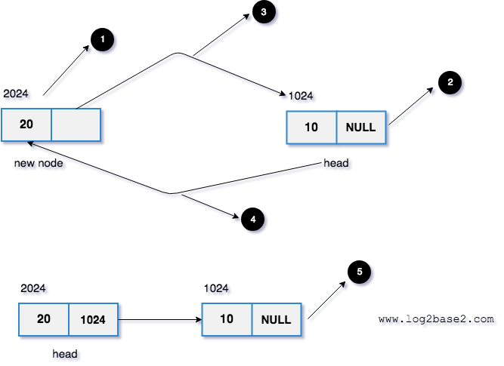
Lecture
SLIDE 6 / 10
Insertion at the Head
1
Create a new node and assign the current head to its next pointer.
2
Update the new node's next pointer to point to the original head.
3
If the list is empty, the new node points to itself as the head.
4
Update the head pointer to reference the newly created node.
Source: www.log2base2.com
Chandigarh University
6 / 10
Notes:
Inserting at the head is straightforward but requires careful pointer manipulation. If the list is empty, the new node points to itself. Otherwise, the new node takes the place of the old head, and the old head becomes the second node. The last node still points to the new head, maintaining the circle.

Slide 7
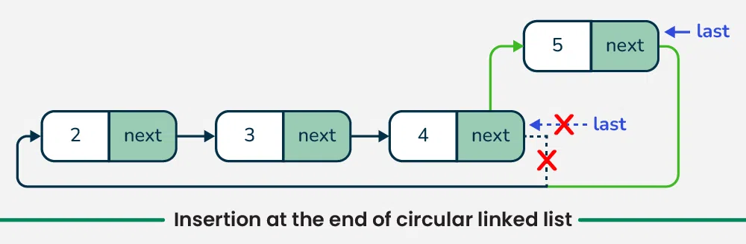
Lecture
SLIDE 7 / 10
Insertion at the Tail
1
Traverse the list to find the current last node (where next equals head).
2
Create a new node and set its next pointer to the current head.
3
Update the current last node's next pointer to reference the new node.
4
The new node becomes the new tail, maintaining the circular structure.
Source: media.geeksforgeeks.org
Chandigarh University
7 / 10
Notes:
Inserting at the tail is slightly more complex because we must find the end first. We traverse until we find a node whose next pointer is the head. We then link this node to the new node, and the new node links back to the head. This effectively extends the circle at the end.

Slide 8
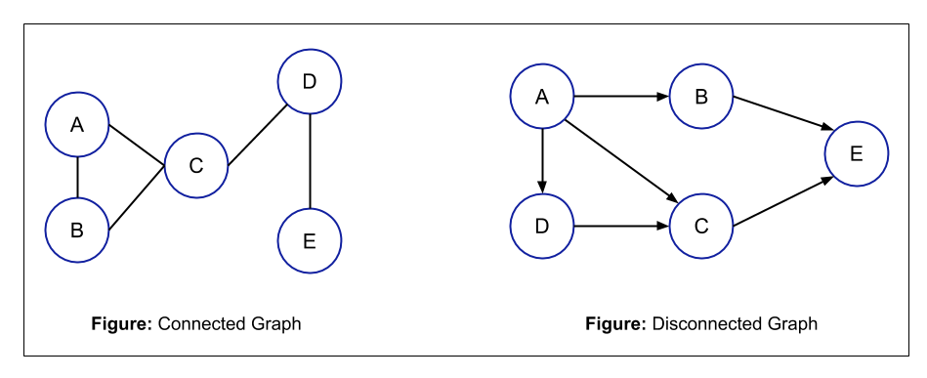
Lecture
SLIDE 8 / 10
Deletion of a Node
1
Locate the node to be deleted and its immediate predecessor in the list.
2
Update the predecessor's next pointer to skip the target node.
3
If deleting the head, update the head pointer to the next node.
4
If deleting the only node, ensure the list becomes empty or points to null.
Source: static.afteracademy.com
Chandigarh University
8 / 10
Notes:
Deletion requires finding the node before the target to update its pointer. If you delete the head, you must update the head pointer to the next node. If the list has only one node, you must handle the special case where the list becomes empty. Always free the memory of the deleted node to prevent leaks.

Slide 9
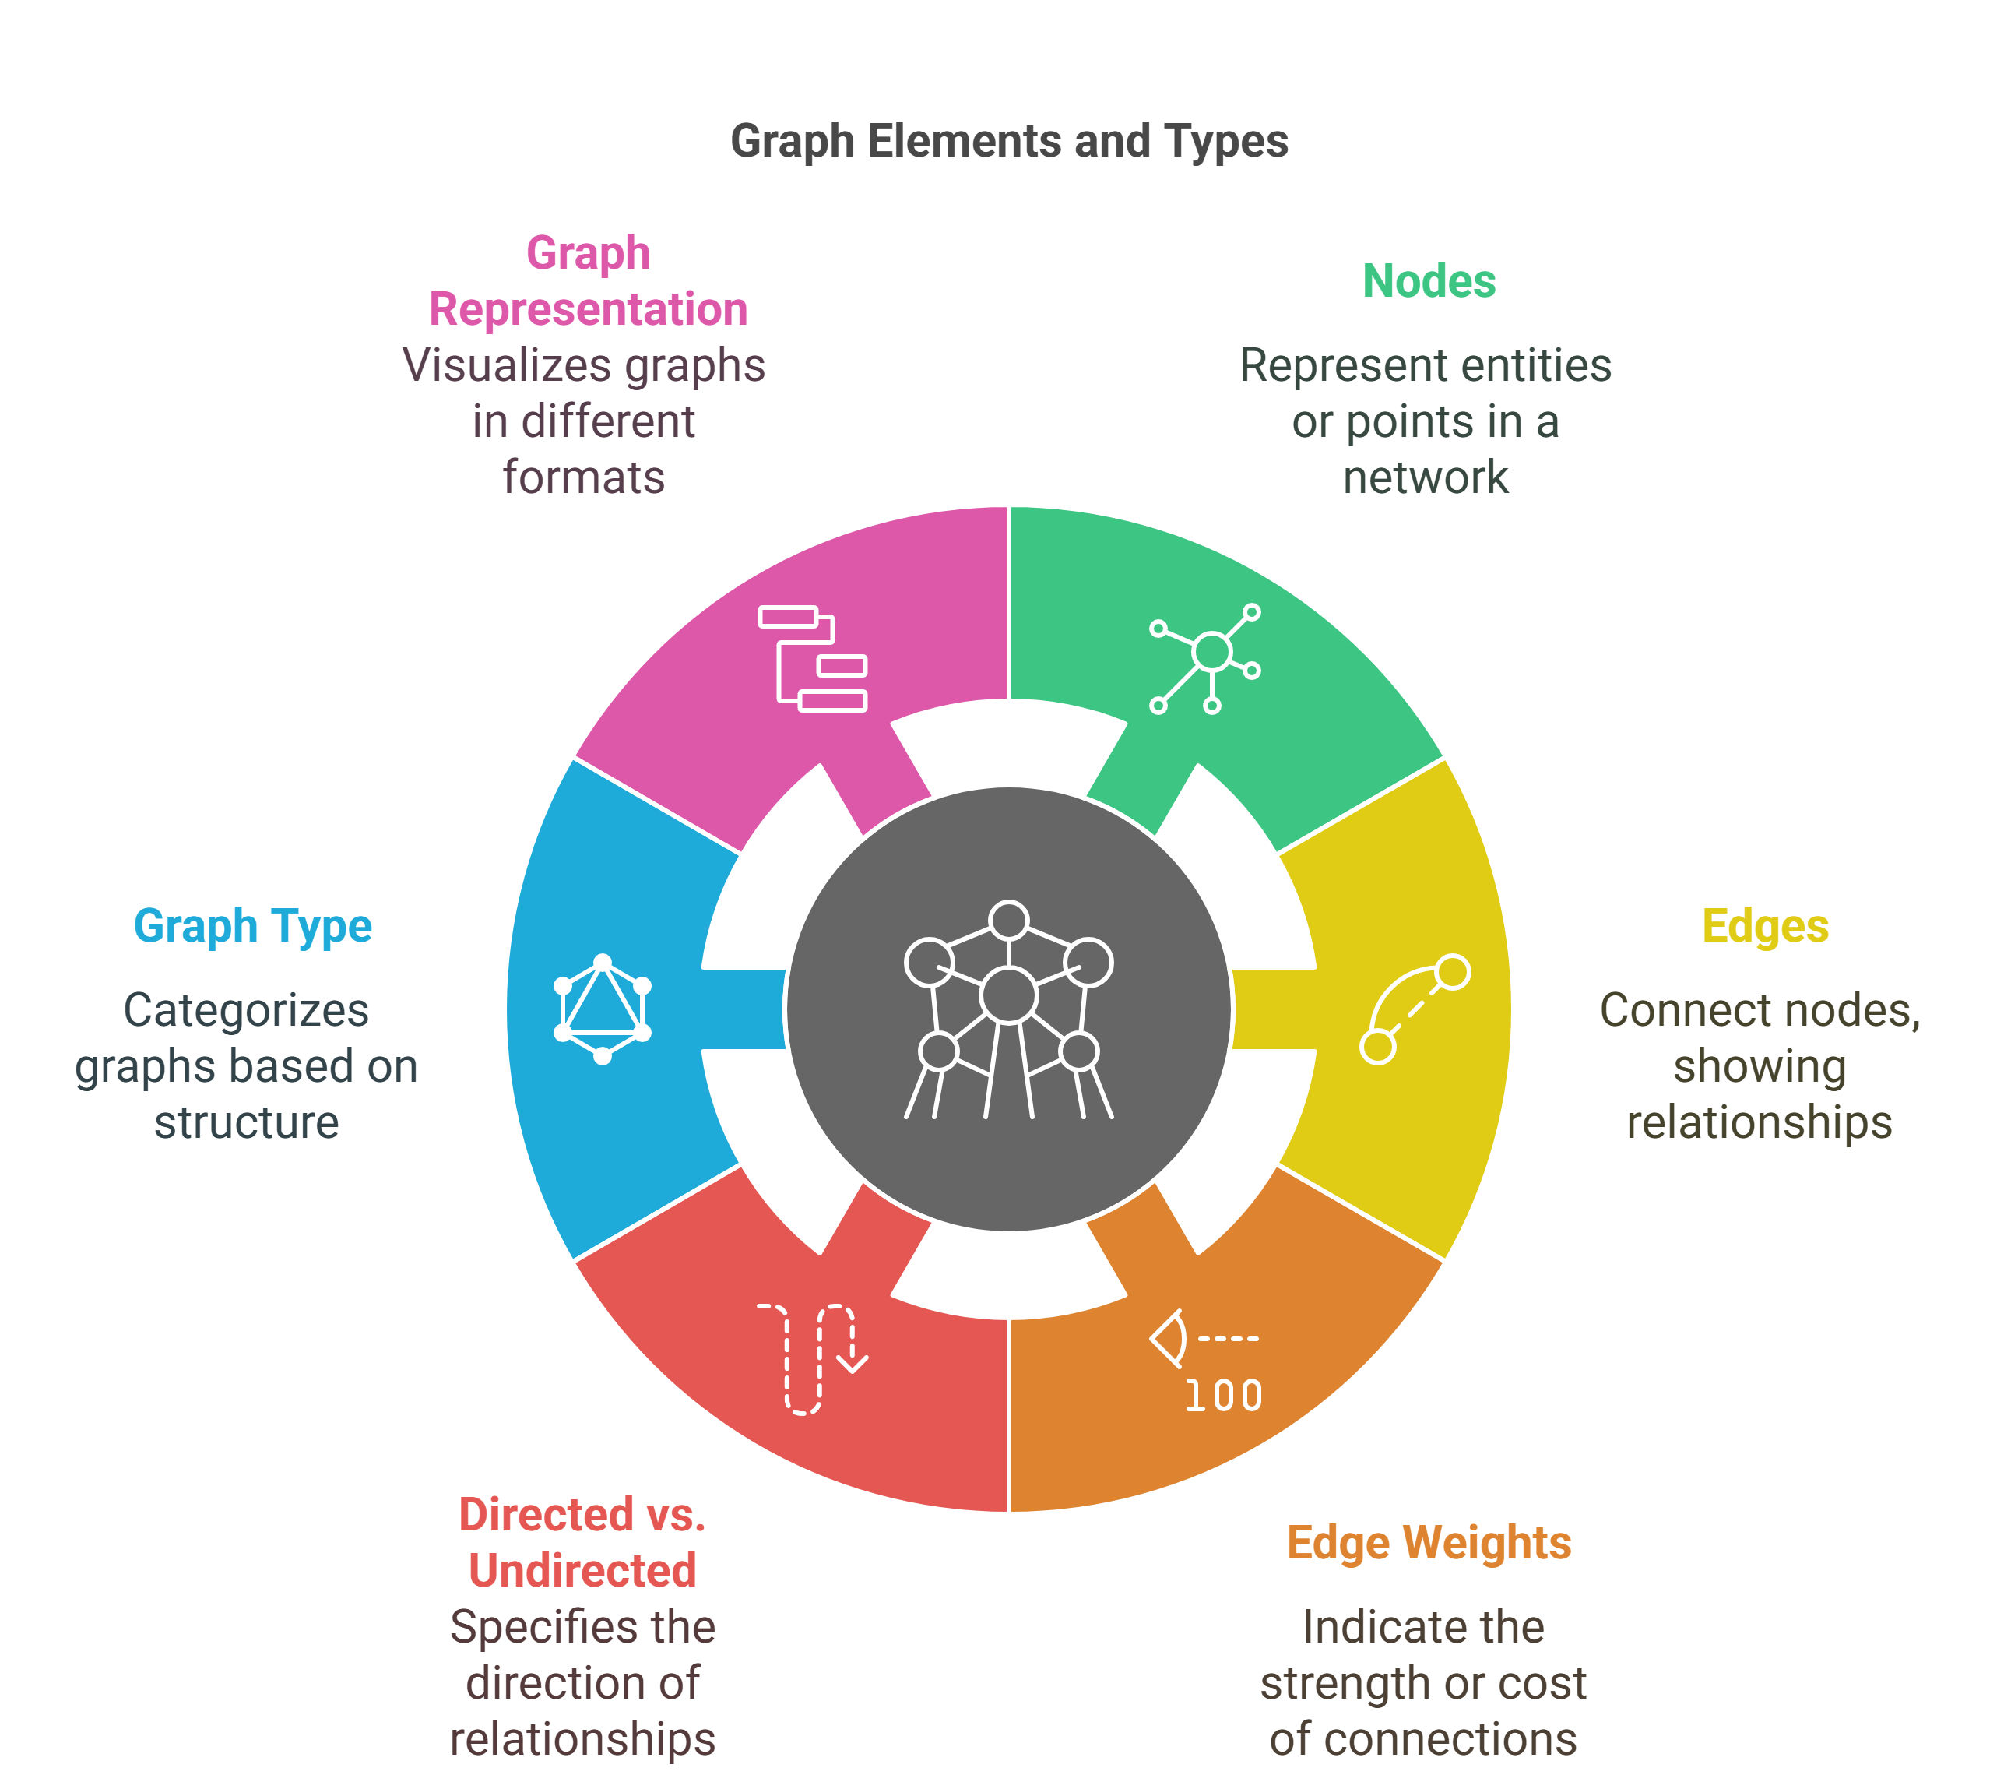
Lecture
SLIDE 9 / 10
Key Takeaways
1
Circular lists form a closed loop with no null terminator at the end.
2
Traversal requires a do-while loop to correctly process the head node.
3
Insertion at head or tail requires updating specific pointers to maintain continuity.
4
Deletion involves re-linking the predecessor to the successor of the target node.
Source: ik.imagekit.io
Chandigarh University
9 / 10
Notes:
To summarize, remember that the defining feature is the lack of a null pointer. Traversal must be handled carefully to avoid infinite loops. Both insertion and deletion require precise pointer updates to keep the circle intact. Mastering these operations is essential for implementing queues and other cyclic data structures.

Slide 10
Lecture
SLIDE 10 / 10
References
DATA STRUCTURES
A Pseudocode Approach with C — Gilberg, Forouzan
• Data Structures — Lipschutz
• Data Structure Using C — AK Sharma
• C and Data structure — P. S. Deshpandey
Chandigarh University
10 / 10
Notes:
These textbooks provide comprehensive coverage of data structures and their implementations in C. I recommend consulting Gilberg and Forouzan for pseudocode approaches and Lipschutz for clear theoretical explanations. AK Sharma's book is excellent for C-specific implementations, while Deshpandey offers practical examples. Please review these resources for further practice.

